Slide 1
Java Enterprise Training
JEE Core Training

Slide 2
Introduction
Servlets and JSP

Slide 3
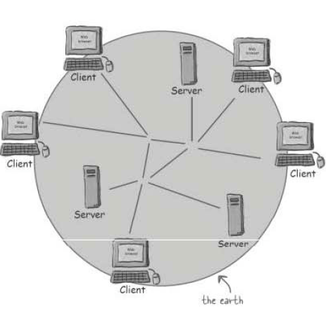
What is JEE?
Java + Application Servers = Software

Slide 4
Why Use Servlets and JSP?
Java is powerful on the enterprise level
Java tools nowadays are more web-based inclined than standalone
The best way of dealing with Java is to practice using the browsers ☺
Because we need scalable, flexible architecture to implement a web site

Slide 5
Web Server vs. Application Server
Web servers are mostly associated with hosting static pages or sites (e.g. PWS)
Application servers (AS) are widely used in software deployment online

Slide 6
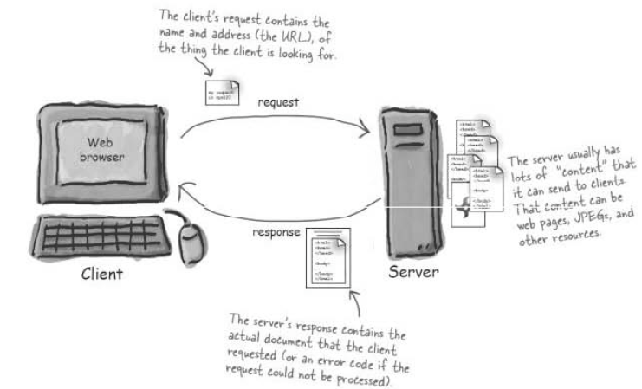
AS and Browsers
A browser lets the user request a resource
An application server gets the request find the resource and send back something to the client

Slide 7
Client-Server Communication
The involvement of servers and browsers gives way to the concept of client-server computing
Types of clients:
Thin client – browser-based communication
Thick client – standalone-based communication

Slide 8
Components of C-S Computing
HTML (Hypertext Markup Language)
tells the browser what to show to the clients
interpreted by web browsers (depending on the version)
HTTP (Hypertext Transfer Protocol)
the communication protocol between the client and server
the client sends HTTP request and the server gives back HTTP response

Slide 9
Components…
Web tools
Some web tools such as CSS, JavaScript, XML, Jason, and other client-side apparels can contribute to client-server transactions
JEE Specification
Read any data sent by the user
Look up any other information about the request that is embedded in the HTTP request

Slide 10
Components…
Generate the results
Format the results inside a document
Set the appropriate HTTP response parameters
Send the document back to the client

Slide 11
The Client
Connotes REQUEST transactions:
A web client lets the user request something on the server and shows the result of the request
Web client can be a user or a browser
Somehow it interprets HTML codes and renders the interpretation of the server to the user

Slide 12
The Server
Connotes RESPONSE transactions:
Respond to the request of the user and brings back some results (i.e. can be null) to the browser
Some popular AS:
Apache Tomcat
Jboss
Weblogic
Websphere Application Server (WAS)
JavaServer Web Development Kit (JSWDK)
GlassFish (Netbeans)

Slide 13
Installations
Application Servers (Apache Tomcat)

Slide 14
Installing Apache Tomcat AS
Be sure to install Java 1.6/1.7 in your end system
Download Apache Tomcat 6/7. This comes in ZIP or MSI files
Unzip or install the installer
Browse the installation folder. Observe the files. Locate the /conf directory

Slide 15
Installing…
Edit the following files found inside the /conf directory:
server.xml – change the shutdown port, connector port, and AJP connector port, if needed. Usually connector port is changed from 80 to something else like 8080

Slide 16
Installing…
context.xml – this contains global information needed for application deployment such as context parameters, environment entries, listeners, request filters and other database-related configuration. For the basic, this can be used to enhance performance by changing <Context> to <Context reloadable="true" privileged="true">

Slide 17
Installation…
web.xml – before this was tweaked to uncomment the servlet invoker XML tags. Since current releases of Tomcat AS has made servlet invoker available default then web.xml is only edited when new MIME extensions are to be introduced into the system
Test the server installed. ☺

Slide 18
Testing the AS
If you have installed AS using the zipped file:
Locate the /bin folder inside the installation folder
Inside the /bin folder click startup.bat or startup.sh
Open your browser (any) and type on the URL bar the following: http://localhost[:8080]/

Slide 19
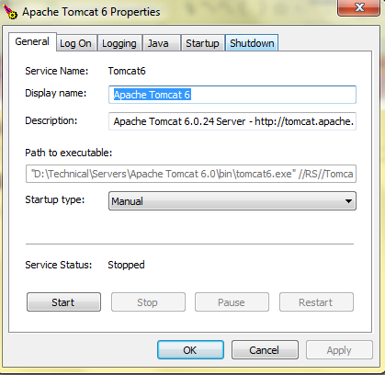
Testing…
If you have installed using the MSI file:
Locate the AS Monitor Panel
Click the START button in order to run the AS
Type on the browser the same URL

Slide 20
Shutting Down
Always shutdown any AS using the Monitor Panel or the shutdown.bat

Slide 21
JEE Starter
JEE Directory Structure

Slide 22
IDE
IDE plays a great role in JEE Development
It is very hard to create JSP and servlet using notepad
JEE plug-ins may help developers create pages and deploy JEE web applications easily

Slide 23
Directory Structures
In dealing with JEE projects, it must be important to deal with the proper JEE directory structures.
There are 2 considerations:
Development environment
Deployment environment

Slide 24
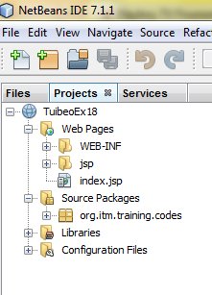
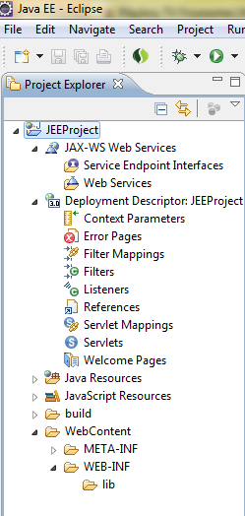
Environment Directory Tree
Different IDE requires developers to have its own predefined directory structure

Slide 25
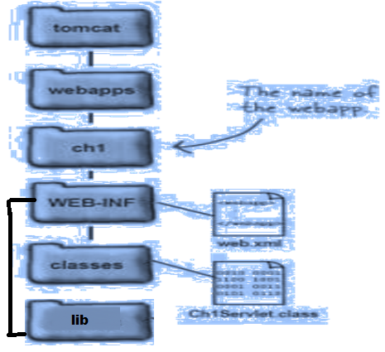
Deployment Directory Structure
The Universal Deployment Structure for all JEE projects, framework or non-framework, on any server container
Common structure
for all AS when it comes
to deployment

Slide 26
JEE Development
The JEE Core development includes the following concepts:
Servlet
Java Server Pages (JSP)

Slide 27
Servlet Programming
Challenges on Servlet

Slide 28
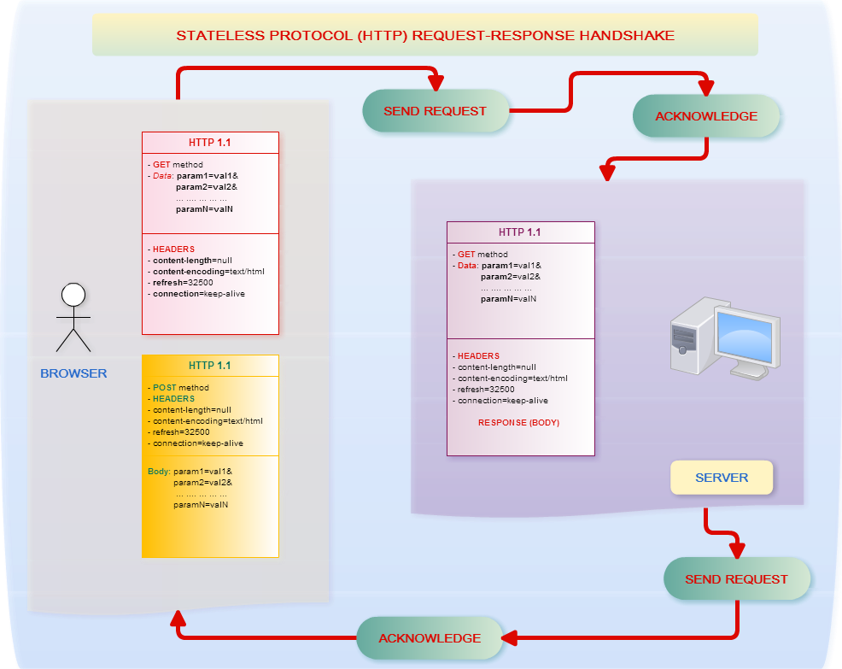
HTTP Protocol

Slide 29
JEE Concepts
The basic core concepts of JEE rely much on HTTP, therefore the main objective of JEE is:
Keep track of the transactions from client to server and the other way around

Slide 30
What are Servlets?
Java classes that dynamically process requests and construct responses
Dynamically generate HTML web pages in response to requests
Sends data in other formats to clients, such as serialized Java objects (applets and Java applications), and XML
Cannot run without AS

Slide 31
Servlets API
There are 2 core packages involved in Servlet programming:
javax.servlet
javax.servlet.http
The first one above is very essential since all servlets came from the class GenericServlet

Slide 32
The Servlet Interface
The Servlet interface defines the lifecycle methods of the basic servlet: initialization, service, and destruction
These lifecycle methods are eventually implemented by the GenericServlet class

Slide 33
GenericServlet class
Defines a generic, protocol-independent servlet
Gives a blueprint and makes writing servlet easier
Provides simple versions of the life-cycle methods init and destroy and of the methods in the ServletConfig interface.
Implements the log method, declared in the ServletContext interface.
To write a generic servlet, it is sufficient to override the abstract service() method.

Slide 34
The service() method
Servlets do not have main() method. Instead, the use service() method which is invoked by the browser
The service() method accepts two parameters:
a request object
a response object

Slide 35
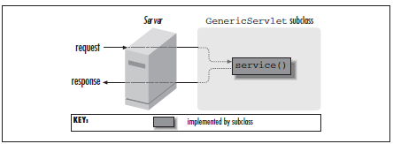
The service()…

Slide 36
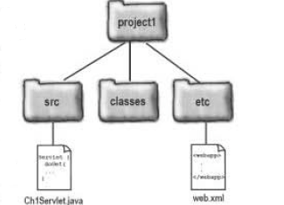
Create a Servlet
Servlets are created inside any packages found in the directory tree of your development directory (i.e. in any IDE)

Slide 37
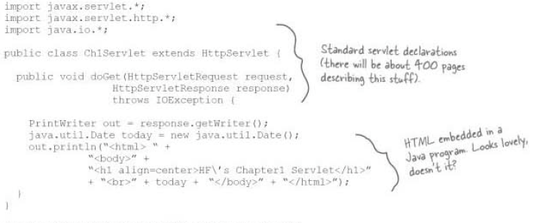
Create…
A simple servlet looks like the following:

Slide 38
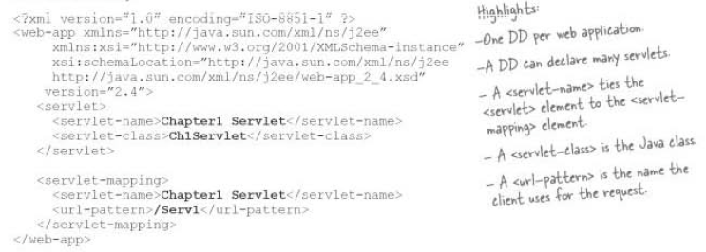
Create…
A servlet cannot run alone. It must be declared inside a web deployment descriptor called web.xml:

Slide 39
Create…
Build the deployment directories manually or you can bypass this step by using Ant build.xml
Using IDE, all servlets are automatically compiled
If manually deployed, copy the .class files into WEB-INF/classes folder of your deployment directory tree and copy web.xml to WEB-INF

Slide 40

Create…
Start Tomcat.
Launch your browser and type in:
Stop Tomcat if changes are done in web.xml and servlets.

Slide 41
Servlet Lifecycle (Stateless)
Initialization occurs when servlets are deployed in a running AS (i.e. init() )
Servlet components then receive requests from the client tier
Servlet do transactions through the server (i.e. service() )
Once processing has been completed a response is returned to the client tier
Destruction occurs when AS destroyed them (i.e. destroy() )

Slide 42
Request and Response Objects
ServletRequest object is the one that holds request information
ServletResponse object is the one that holds response information

Slide 43
What’s wrong with GenericServlet?
It lacks methods that will transact with the browser
It cannot interact mainly with different HTTP transactions

Slide 44
HttpServlet API
To interact with HTTP information, we need HttpServlet and its methods
To be an HTTP servlet, a class should extend HttpServlet
APIs of HTTP servlets are found in javax.servlet.http package
It adds support for HTTP specific functions including the HTTP GET or POST methods

Slide 45
HTTP Information
After the status line, the server sends response headers that tell the client things like what software the server is running and the content type of the server’s response.
Date: Saturday, 23-May-98 03:25:12 GMT
Server: JavaWebServer/1.1.1
MIME-version: 1.0
Content-type: text/html
Content-length: 1029
Last-modified: Thursday, 7-May-98 12:15:35 GMT

Slide 46
HTTP Request and Response
The object that carries request information here is HttpServletRequest
The object that carries response information here is HttpServletResponse

Slide 47
What happened to service()?
The HttpServlet class defines two service() methods to process requests:
The first of these overrides the service() method inherited from GenericServlet:
void service(ServletRequest req, ServletResponse res)
The second one casts the ServletRequest and ServletResponse objects into their corresponding HTTP objects (HttpServletRequest and HttpServletResponse) :
protected void service(HttpServletRequest req, HttpServletResponse res)

Slide 48
HTTP Transactions
HTTP protocols has been used a long time ago during the advent of Common Gateway Interface (CGI) either written in Perl or C
HTTP is a simple, stateless protocol
When the client sends a request, the first thing it specifies is an HTTP command, called a method, that tells the server the type of action it wants performed. This first line of the request also specifies the address of a document (a URL) and the version of the HTTP protocol it is using

Slide 49
HTTP Information
Example header:
GET /intro.html HTTP/1.0
Other header options:
User-Agent: Mozilla/4.0 (compatible; MSIE 4.0; Windows 95)
Accept: image/gif, image/jpeg, text/*, */*
After the headers, the client sends a blank line, to indicate the end of the header section.

Slide 50
HTTP Information
After the client sends the request, the server processes it and sends back a response. The first line of the response is a status line that specifies the version of the HTTP protocol the server is using, a status code, and a description of the status code.
HTTP/1.0 200 OK

Slide 51
HTTP Service methods
The service method checks the HTTP request type (GET, POST, PUT, DELETE, etc) and calls doGet, doPost, doPut, doDelete, etc
It would be best to use doPost() or doGet() rather than override service() method

Slide 52
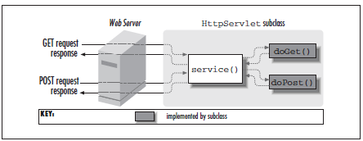
Do we need to use service()?
In contrast, an HTTP servlet usually does not override the service() method. Instead, it overrides doGet() to handle GET requests and doPost() to handle POST requests. An HTTP servlet can override either or both of these methods

Slide 53
Do we need…
Overriding service() directly precludes adding support for other services
There is date modification for doGet() methods
There is automatic support for HEAD requests. HEAD is a useful request method for custom HTTP clients
You get automatic support for OPTIONS requests
You get automatic support for TRACE requests which is a request method for debugging

Slide 54
HTTP Request Methods
GET – asks to get thing (resource/file) at the requested URL
POST – asks the server to received the body of info attached to the request and give it to the thing at the requested URL
HEAD – asks only the header part of whatever a GET would return
TRACE – asks for a loopback of the request message

Slide 55
PUT – says to put the enclosed info at the requested URL
DELETE – says to delete the thing (resource/file) at the requested URL
OPTIONS – asks for the list of HTTP methods to which the things at the requested URL can respond
CONNECT – says to connect for the purpose of tunneling

Slide 56
POST and GET
There are two popular HTTP request methods:
GET
POST
If the HTTP request method is GET, the service() method invokes doGet()
If the HTTP request method is POST, the service() method invokes doPost()

Slide 57
POST and GET
The difference between POST and GET is the presence of a body in POST
Both POST and GET can send parameters but with GET there are only limited data to send than POST

Slide 58
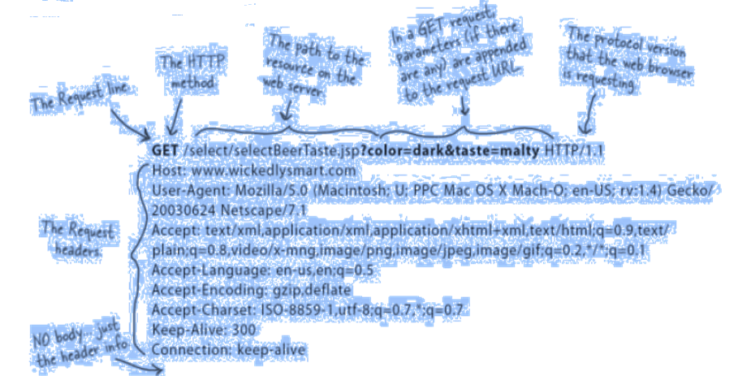
GET Transaction

Slide 59
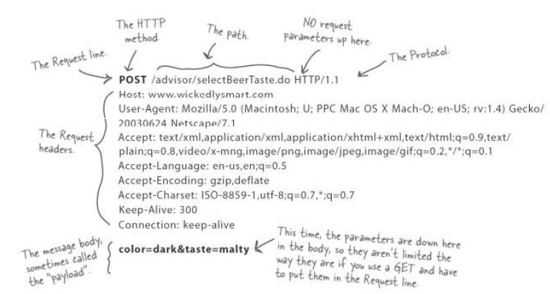
POST Transaction

Slide 60
GET or POST?
A simple hyperlink always means GET
During <form> declaration, when method=“POST” is specified then the method used is POST
The default method in <form> is GET

Slide 61
Request Transactions
Handshake Rule (Part 1)

Slide 62
Servlet Transactions
Servlet processing involves the following:
Form Handling
Knowing the Header Information of the request
Knowing the Server and Client information of the request transaction

Slide 63
Handling Form Data
<HTML>
<HEAD>
<TITLE>Introductions</TITLE>
</HEAD>
<BODY>
<FORM METHOD=GET ACTION="/servlet/Hello">
If you don't mind me asking, what is your name?
<INPUT TYPE=TEXT NAME="name"><P>
<INPUT TYPE=SUBMIT>
</FORM>
</BODY>
</HTML>

Slide 64
Form Data Transaction
import java.io.*;
import javax.servlet.*;
import javax.servlet.http.*;
public class Hello extends HttpServlet {
public void doGet(HttpServletRequest req, HttpServletResponse res)
throws ServletException, IOException {
res.setContentType("text/html");
PrintWriter out = res.getWriter();
String name = req.getParameter("name");
out.println("<HTML>");
out.println("<HEAD><TITLE>Hello, " + name + "</TITLE></HEAD>");
out.println("<BODY>");
out.println("Hello, " + name);
out.println("</BODY></HTML>");
}
public String getServletInfo() {
return "A servlet that knows the name of the person to whom it's" +
"saying hello";
} }

Slide 65
HTML Components
All request data ALWAYS come from <form> components of an HTML page:
Textbox
Combobox
RadioButton
Checkbox
Textarea

Slide 66
Request Data Access
Using HttpServletRequest, there are 3 types of accessing the data:
getParameter()
If the component name is known and used if we have single data component
getParameterValues()
If the component name is known and we have multi-valued components
getParameterNames()/getParameterValues()
If the components names are unknown whether single- or multi-valued

Slide 67
For GET Transactions
Given a GET method transaction,a servlet can retrieve the raw query string of the request with getQueryString() (an encoded GET parameter information)
public String ServletRequest.getQueryString()
Trivia
What will happen to the value of getQueryString() if we have a POST method? ☺

Slide 68
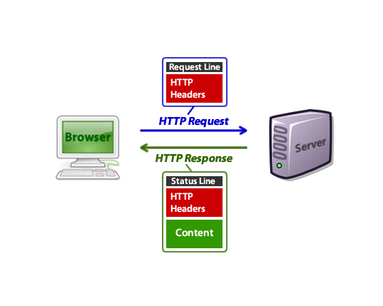
Request Header Information
Request Headers are information sent by HTTP 1.1 protocol and it describes about the server, browser, and the data sent by the client

Slide 69
Request Header Retrieval
Using HttpServletRequest, we have the following methods to use for header access:
getHeader()
getHeaderNames()
getIntHeader()
Note:
You cannot change REQUEST header information

Slide 70
Client and Server Information
Some popular methods used to access server information of the clients:
public String ServletRequest.getServerName()
public int ServletRequest.getServerPort()
Some methods used to know the users:
public String HttpServletRequest.getRemoteUser()
public String HttpServletRequest.getAuthType()
public String ServletRequest.getRemoteAddr()
public String ServletRequest.getRemoteHost()

Slide 71
HTTP Requests
The HttpServletRequest represents the client’s request.
This object gives a servlet access to information about the client, the parameters for this request, the HTTP headers passed along with the request, and so forth.

Slide 72
Servlet Reloading
Servlets found inside webapps/mywebapp/classes directory are not automatically updated once you debugged their sources
To update the servlets, you need to redeploy the project
Only servlets found in webapps/ROOT/classes can perform servlet reloading
Servlet reloading is not recommended!

Slide 73
Response Transaction
Handshake Rule (Part 2)

Slide 74
Servlet Transactions
The main transaction involving response object is:
To generate output
To add more header information
To traverse pages or choose pages
To create sessions and other related web components important to storing state

Slide 75
HTTP Response
Response to the clients contains the following:
Status code
Response Headers
Body of Data (Result)
This data can be of any content type, though the type should be specified as part of the response.

Slide 76
Page Generation
The process of generating HTML pages inside any servlet is called Page Generation
There are APIs that overrides the manual processing but most of the time this is done manually ☹
Page generation happens when servlet uses PrintWriter class to embed HTML tags to publish websites
This is the only process of publishing websites using servlets ☹

Slide 77
Response Headers
Response headers are information that we can attach to an output or result from request-response transactions
Note:
Adding new headers must be handled with care cause not all headers are applicable to a certain output
By default, response object has 3 setters for the following header information:
content-type
content-length
character-encoding

Slide 78
Rendition Types
Part of the headers is to manipulate the rendition types of the result
MIME types
Visit /conf/web.xml for some supported MIME types of response method:
Text/html
Application/pdf
Video/quicktime
Application/java
Image/jpeg
Application/jar
Application/octet-stream
Application/x-zip
Please visit http://www.webmaster-toolkit.com/mime-types.shtml

Slide 79
Two types of Output Objects
PrintWriter
An I/O file stream object returned by getWriter() method
Can send character text to the client
Uses the character encoding returned by getCharacterEncoding()
If the response's character encoding has not been specified as described in getCharacterEncoding (i.e., the method just returns the default value ISO-8859-1), getWriter updates it to ISO-8859-1

Slide 80
Types…
ServletOutputStream or OutputStream
An I/O data stream objet return by getOutputStream()
Used for binary content (bytes)
Suitable for writing binary data in the response
The servlet container does not encode the binary data, it sends the raw data as it is
Applicable for rendering videos or images
Stream objects needed (e.g. DataInputStream)

Slide 81
Types…
Basic process:
Sample Code:
InputStream binaryIn = getServletContext().getResourceAsStream(“file"); BufferedInputStream bis = new BufferedInputStream(binaryIn); DataInputStream dis = new DataInputStream(dis);
resp.setContentType("application/octet-stream"); ByteArrayOutputStream byteOut = new ByteArrayOutputStream(); DataOutputStream out = new DataOutputStream(byteOut); out.writeInt(count); out.flush(); byte[] buf = byteOut.toByteArray(); resp.setContentLength(buf.length); ServletOutputStream servletOut = resp.getOutputStream(); servletOut.write(buf); servletOut.close();

Slide 82
ByteArrayOutputStream
Since ServletOutputStream is low-level API, it needs to instantiates ByteArrayOutputStream
Contains an array of bytes that grows as necessary to accommodate whatever output the servlet sends.
When the servlet is ready to exit, it sets the content length to be the size of the buffer and then sends the contents of the buffer to the client

Slide 83
Status Codes
JEE Exception Handling

Slide 84
Status Codes
The most common status code numbers are defined as mnemonic constants (public final static int fields) in the HttpServletResponse class
This is used hand-in-hand with try-catch block and with <error-page> in web.xml
Refer to handout on Status Codes

Slide 85
Status Codes…
The code can be specified as a number or with one of the SC_XXX codes defined within HttpServletResponse
There are two commands connected with status codes:
setStatus()
public void HttpServletResponse.setStatus(int sc)
public void HttpServletResponse.setStatus(int sc, String sm)

Slide 86
Status Codes…
sendError()
public void HttpServletResponse.sendError(int sc)
public void HttpServletResponse.sendError(int sc, String sm)

Slide 87
When to use setStatus?
If you want to provide your own error message and all exception handling mechanism 100%, use setStatus()
sendRedirect() is used together with setStatus() to trigger error pages
No automatic with setStatus()
This also updates the STATUS data of the response object

Slide 88
When to use sendError()?
This triggers the <error-page> of the web.xml or the default error page of the container

Slide 89
Sample
String page = request.getParameter("page");
if (page != null && page.equals("inputForm")) {
response.setStatus(response.SC_OK);
} else {
response.sendError(response.SC_NOT_FOUND,
"The requested page ["
+ page + "] not found.");
}

Slide 90
Exception Handling and Error Handling
try {
firstName.substring(6);
}
catch (NullPointerException e) {
out.println("File not found");
}

Slide 91
Exception…
try {
firstName.substring(6);
}
catch (NullPointerException e) {
res.sendError(res.SC_NOT_FOUND);
}

Slide 92
Exception…
Steps in JEE Error and Exception handling:
Use try-catch or if-statements on areas where errors can probably found
Evaluate what type of Exception or error
Call setStatus() or sendError() on catch-statement or if-statement
Using sendError(), you can create error pages in HTML or JSP format and declare them in web.xml

Slide 93
JEE Data
Parameters and Attributes

Slide 94
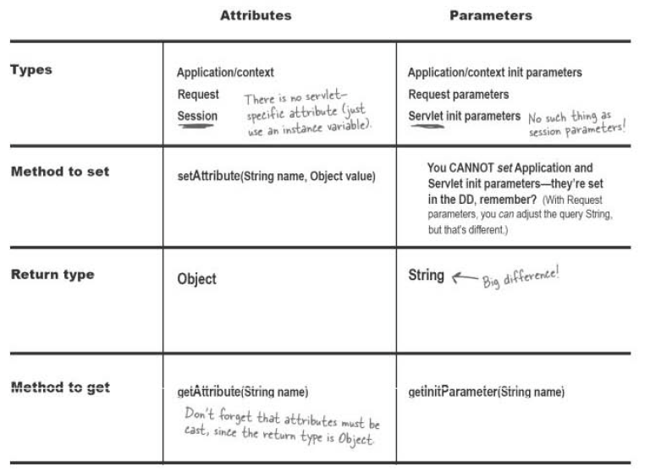
Parameters vs. Attributes

Slide 95
Parameters
Always strings and if there are no parameters it just contains null
Always fixed and cannot be changed
Manually entered by developers
Can be classified as:
Request parameters
Servlet Initialization Parameters/Init Param
Context Initialization Parameters/ Context Param

Slide 96
Initialization Parameters
If there are no initialization parameters, we use the init() method without the local argument. Else, we will be using the overloaded one.
Public void init(ServletConfig config)

Slide 97
ServletConfig Interface
The servlet container uses a ServletConfig object to pass initialization information to the servlet
It is only this object that init parameters are retrieved
Only found in init() method

Slide 98
Context Parameters
These parameters are global and can be accessed by any JSP or servlets
Can be accessed through ServletContext object

Slide 99
ServletContext Interface
The ServletContext object is used to communicate with the servlet container when we want to perform actions such as writing to a log file or dispatching requests
There is only one ServletContext object per web application in the JVM
This is initialized when the web application is started and destroyed only when the web application is being shutdown
ServletContext is the object equivalent of your web.xml ☺

Slide 100
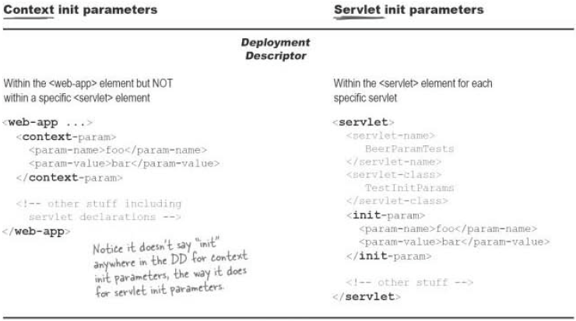
Comparative Analysis (Summary)

Slide 101
Attributes
These are the public, private, protected, and default objects we have in our Java SDK
These are all objects subject for access by any JSP or servlets
They are subject for updates and removal
Needs to have try-catch statements during accessing them to avoid server errors

Slide 102
Attribute Classification
Request Attributes
Attributes present only during request dispatch process
Session Attributes
Attributes present only during session handling
Application/Context Attributes
Attributes present all the time and globally once the server started

Slide 103
Request Dispatch
Request Attributes

Slide 104
Request Dispatch
Is called servlet chaining or calling a servlet in a chain formation
The first servlet initiates the chaining
There is only a sole owner of the request and response object, the first servlet
Purpose: divide and conquer strategy
MUST Requirement
no HTML or JSP interfering the chain there will be no chain at all

Slide 105
Implementation
Comes into 2 types:
Forward request dispatch
RequestDispatcher dispatch = request.requestDispatcher(“[/grp/]url-pattern);
dispatch.forward(request, response);
Include request dispatch
RequestDispatcher` erdispatch = request.requestDispatcher(“[/grp/]url-pattern);
dispatch.include(request, response);

Slide 106
How does Request Dispatch works?
These are indicators that we are running request dispatch processing:
The URL shown on the browser is the start servlet only
There is only one pair of request and response object per chain
If the HTTP method used is Get by the start servlet, doGet() service method is used the entire chain. Otherwise, doPost() method

Slide 107
Client or Server?
Request Dispatch process is being done by the AS
Browser has nothing to do with request dispatch

Slide 108
What is the big deal?
With request dispatch comes request attributes
Steps:
Create first any object to share throughout the chain
Register object as request attribute:
request.setAttribute(“objectName”, object);
To retrive the request attribute:
request.getAttribute(“objectName”);
Any servlet on remove the attribute:
request.removeAttribute(“objectName”);

Slide 109
MVC Pattern
JEE Web Development

Slide 110
MVC Concepts
MVC stands for Model-View-Controller
Model Layer: This includes the POJO, and data providers. These are non-servlets.
Controller Layer: This includes the main transactions of the software. These are servlets.
View Layer: This includes the form and result pages. These are servlets.

Slide 111
Session Handling
Session Attributes

Slide 112
Session Handling
Technically, this is the only way that we can compensate the HTTP’s stateless behavior
On the high level, session handling is the process of sharing various data object within an exclusive membership of servlets
Sample uses:
Tracking users and pages
Data integrity
Auditing transactions

Slide 113
How to create sessions?
To create session, an ordinary servlet must invoke and create:
HttpSession session = request.getSession(true);
NOTE: By default getSession() is set to false! ☺

Slide 114
How to be part of the session?
Any servlet who are to be part of a session must have:
HttpSession session = request.getSession();
NOTE: There are 1 overload of getSession(), this one without the parameter is only for membership and for accessing existing session

Slide 115
What is the catch?
Session handling connotes session attributes, the object to be shared within the group of servlets.
To create session attributes:
session.setAttribute(“objectName”, object);
NOTE: Do not use putValue() it is obsolete
To retrieve session attributes:
session.getAttribute(“objectName”);
To remove session attributes:
session.removeAttribute(“objectName”);

Slide 116
Other Session-related Methods
public boolean HttpSession.isNew()
public void HttpSession.invalidate()
public long HttpSession.getCreationTime()
public long HttpSession.getLastAccessedTime()
Each of these methods can throw a java.lang.IllegalStateException if the session being accessed is invalid
public String[] HttpSession.getAttributeNames()
public void HttpSession.removeAttribute(String name)

Slide 117
Session Objects
Sessions do not last forever.
A session either expires automatically, after a set time of inactivity
When a session expires (or is invalidated), the HttpSession object and the data values it contains are removed from the system

Slide 118
Where are Session stores?
Session information are found in the browser cache as Cookie
Thus, there will be a problem when browser does not allow Cookie
Solution: Session information can be sent as art of the URL

Slide 119
Storing Sessions in URL
Many web servers also support session tracking based on URL rewriting, as a fallback for browsers that don’t accept cookies. This requires additional help from servlets
For a servlet to support session tracking via URL rewriting, it has to rewrite every local URL before sending it to the client

Slide 120
Sessions in URL…
Two ways to perform the process:
public String HttpServletResponse.encodeUrl(String url)
used inside JSP form tags and anchor tags
public String HttpServletResponse.encodeRedirectUrl(String url)
used inside the servlet with sendRedirect()

Slide 121
Storing Detection
A servlet can detect whether the session ID used to identify the current HttpSession object came from a cookie or from an encoded URL using the isRequestedSessionIdFromCookie() and isRequestedSessionIdFromUrl() methods
public boolean HttpServletRequest.isRequestedSessionIdFrom
Cookie()
public boolean HttpServletRequest.isRequestedSessionIdFromUrl()

Slide 122
Detection…
Determining if the session ID came from another source, such as an SSL session, is not currently possible.
A servlet can determine whether a requested session ID is valid using isRequestedSessionIdValid():
public boolean HttpServletRequest.isRequestedSessionIdValid()

Slide 123
Other Session Information Methods
Behind the scenes, the session ID is usually saved on the client in a cookie or sent as part of a rewritten URL
A servlet can discover a session’s ID with the getId() method:
public String HttpSession.getId()
All valid sessions are grouped together in a HttpSessionContext object.
public HttpSessionContext HttpSession.getSessionContext()

Slide 124
Other Sessions…
Once you have an HttpSessionContext, it’s possible to use it to examine all the currently valid sessions with the following two methods:
public Enumeration HttpSessionContext.getIds()
public HttpSession HttpSessionContext.getSession(String sessionId)

Slide 125
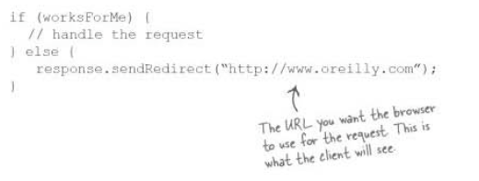
Calling Servlet for Session
Servlet Redirection
Also can be used for static pages like HTML
Client-side transaction
Browser URL changes as redirection is done

Slide 126
Cookie Handling
A Cookie is a bit of information sent by a web server to a browser that can later be read back from that browser
When a browser receives a cookie, it saves the cookie and thereafter sends the cookie back to the server each time it accesses a page on that server, subject to certain rules
Because a cookie’s value can uniquely identify a client, cookies are often used for session tracking

Slide 127
How to Create Persistent Cookies?
Instantiate a Cookie object through the GenericServlet API called Cookie():
public Cookie(String name, String value)
A servlet can send a cookie to the client by passing a Cookie object to the addCookie() method of HttpServletResponse:
public void HttpServletResponse.addCookie(Cookie cookie)

Slide 128
Rules on Cookie Information
Cookie name and cookie are String of alphanumeric, numbers, combination of numbers and alphanumeric except on special characters:
The special characters are white-space characters, double quote, comma, semicolon and backslash. Equals is not a special character.
The special characters cannot be used at all, with the exception that double quotes may surround the value.
Special characters cannot be quoted.
Backslash does not act as an escape.

Slide 129
Trivia on Cookies
Cookie object is a POJO or Java Bean
Because cookies are sent using HTTP headers, they should be added to the response before you send any content ☺
Browsers are only required to accept 20 cookies per site, 300 total per user, and they can limit each cookie’s size to 4096 bytes ☹

Slide 130
Retrieving Cookies
A servlet retrieves cookies by calling the getCookies() method of HttpServlet-Request
public Cookie[] HttpServletRequest.getCookies()
This method returns an array of Cookie objects that contains all the cookies sent by the browser as part of the request or null if no cookies were sent

Slide 131
Essence of Cookies to Session
Since sessions are stored as Cookies, we can manipulate session information through cookie handling:
The session name for the servlet session is JSESSIONID
We can set expiration to the session via setting expiry age method:
setMaxAge()

Slide 132
Overwriting Cookies
If cookies are needed to be updated, just retrieve them, update the setters and addCookie() them back ☺

Slide 133
Deleting Cookies
To delete cookies, just setMaxAge() to 0.

Slide 134
Context-AWare
Context Attributes

Slide 135
What is context-aware property?
All data and processes are called globally
Uses listeners
Uses the web.xml property

Slide 136
ServletContext
All JSP and servlet accesses all that are global from this object ONLY!
This object is also used to declare context attributes

Slide 137
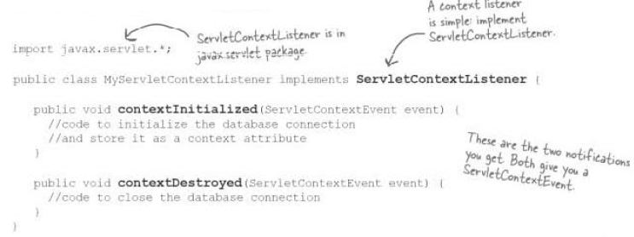
ServletContextListener
A separate class that listens to the key events to ServletContext’s life initialization and destruction

Slide 138
Filter
Interceptors

Slide 139
What is a Filter?
An object that intercepts a message between a data source and a data destination, and then filters the data being passed between them
It acts as a guard, preventing undesired information from being transmitted from one point to another

Slide 140
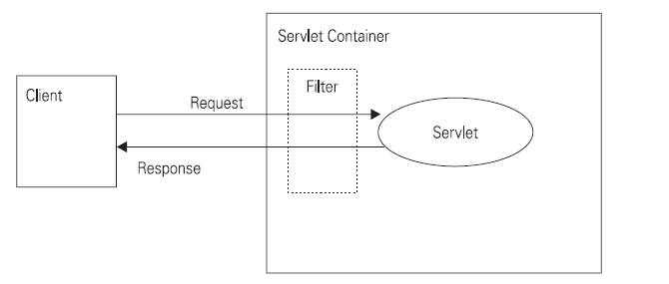
Model

Slide 141
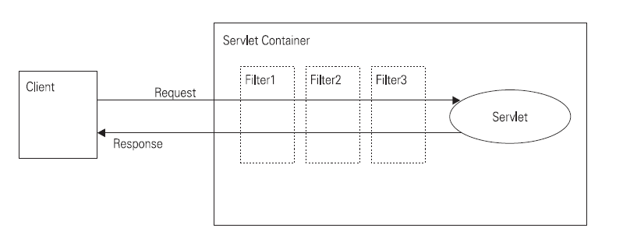
Model…

Slide 142
How Filter works
When a servlet container receives a request for a resource, it checks whether a filter is associated with this resource
If a filter is associated with the resource, the servlet container routes the request to the filter instead of routing it to the resource
After all server transactions, response information will be routed first to the servlet then to the client

Slide 143
Filter Dispatcher Types
REQUEST
Only when the request comes directly from the client
FORWARD
Only when the request has been forwarded to a component
INCLUDE
Only when the request is being processed by a component that has been included
ERROR
Only when the request is being processed with the error page mechanism
Note: You can direct the filter to be applied to any combination of the preceding situations by selecting multiple dispatcher types. If no types are specified, the default option is REQUEST.

Slide 144
Types of Filter Model
One filter on One Servlet
One filter on Multiple Servlets
apply handler path for each servlet
group name of servlets
Multiple Filters on a Servlet

Slide 145
Servlet Container Versions
2.5
Strictly XML-based
All components must be declared in your deployment descriptor
3.x
Uses annotations

Slide 146
Servlet Declaration
@WebServlet (name="mytest",
urlPatterns={"/myurl"},
initParams={ @WebInitParam(name="n1", value="v1"),
@WebInitParam(name="n2", value="v2") })
public class MyServlet extends HttpServlet{
public void handleGet(HttpServletRequest req,
HttpServletResponse res) {
....
}
}

Slide 147
Listener
@WebListener
public class MyListener implements ServletContextListener{
public void contextInitialized (ServletContextEvent sce) {
}
.....
}

Slide 148
Filter
@WebFilter(urlPatterns={"/myurl"}.
initParams={ @InitParam(name="mesg",
value="my filter") })
public class MyFilter implements Filter {
public void doFilter(HttpServletRequest req,
HttpServletResponse res) {
.....
}
}

Slide 149
Jsp (Non-JSTL)
Introduction to Java Server Pages (JSP)

Slide 150
Why JSP?
JavaServer Pages (JSP) addresses these concerns. JSP pages are text files similar to HTML files but have extra tags that allow us to:
Interact with dynamic content
Include content from other web application resources
Forward the response to other web application resources
Perform custom processing on the server when the page is served by the web container

Slide 151
Servlet vs. JSP
Although servlets are powerful web components, they are not the ideal technology available to us to build presentation elements. This is because:
Amending the look and feel of the system involves recompiling the servlet classes
The presence of HTML within the servlets tightly couples the presentation and the content, which blurs the roles of presenting and providing content
Lots of HTML code within the servlet classes make them difficult to maintain

Slide 152
JSP (Non-JSTL)
JSP pages are converted to servlets by the JSP container in a process that is transparent to the developer
Technically, JSP is a specialized servlet
There are three kinds of scripting element in JSP:
declarations
scriptlets
expressions
comments

Slide 153
Declaration
Declarations are used to define methods and instance variables.
They do not produce any output that is sent back to the client.
Declarations in JSP pages are embedded between <%! and %> delimiters

Slide 154
Scriptlet
Scriptlets are used to embed Java code within JSP pages.
The contents of scriptlets go within the:
public void _jspService(final javax.servlet.http.HttpServletRequest request, final javax.servlet.http.HttpServletResponse response) throws java.io.IOException, javax.servlet.ServletException
The lines of code embedded in JSP pages should comply with the syntactical and semantic constructs of Java
Scriptlets are embedded between <% and %> delimiters

Slide 155
Expression
Expressions in JSP pages are used to write dynamic content back to the browser and are embedded in <%= and %> delimiters.
If the output of the expression is a Java primitive, the value of the primitive is printed back to the browser.
If the output is a Java object, the result of calling the toString() method on the object is written back to the browser.

Slide 156
Comments
Comment in JSP is used to comment on the JSP pages
Denoted by <%-- --%>
This is preferred rather than HTML comment since these lines are not included in the page generation

Slide 157
Directives
Directives are messages sent by the JSP author to the JSP container to aid the container in the process of page translation
These directives are used by the JSP container to import tag libraries, import required classes, set output buffering options, and include content from external files
The JSP specification defines three directives:
page (<%@ page %>)
include (<%@ include %>)
taglib (<%@ taglib %>)

Slide 158
What are these directives?
page
provides general information about the page, such as the scripting language that is used, content type, or buffer size
important in importing API libraries and session handling
include
used to include the contents of external files
used for physical file augmentation
taglib
used to import predefined and custom API actions defined in tag libraries

Slide 159
Samples of Directives
The page Directive
<%@ page language="java" buffer="10Kb" autoFlush="true" errorPage="/error.jsp" import="java.util.*,javax.sql.RowSet" %>
The include Directive
<%@ include file="included.jsp" %>
The taglib Directive
<%@ taglib prefix=“c“ url=“http://www.java.sun.com/jsp/jstl/core” %>

Slide 160
Implicit Objects
In JSP, some of the essential GenericServlet and HttpServlet APIs are already compiled.
These compiled objects are called implicit objects

Slide 161
Implicit…
There are nine commonly used variables in _jspService() method:
application → ServletContext
session → HttpSession
request → HttpServletRequest
response → HttpServletResponse
out → JspWriter (a subclass of PrintWriter)
page → Object
pageContext → JSP’s version of ServletContext
config → ServletConfig
exception → Throwable

Slide 162
JSP-JSTL
Journey to the Framework World

Slide 163
What’s wrong with Scriptlets?
JSP with scriptlet will eventually violate the purpose of JSP: PRESENTATION!
Even though JSP is a servlet it was still created to focus more on the VIEWS without abandoning its servlet’s characteristics
Scriptlet makes JSP code complicated and intricating

Slide 164
SOLUTION!
Develop and use Tag Libraries! ☺
But before the Tag Library era, several projects were innovated to disregard the scriptlet content of JSP

Slide 165
Attempt 1: JSP Actions
JSP actions are processed during the request processing phase (as opposed to directives, which are processed during the translation phase)
The JSP specification defines a few standard actions that must be supported by all compliant web containers
JSP also provides a powerful framework for developing custom actions, which are included in a JSP page using the taglib directive

Slide 166
What are the JSP Actions?
Request Dispatch Processes:
The <jsp:include/> Action
the contents of the included resource is substituted into the JSP page at translation phase but with the include action the response of the included resource is added to the current response output stream during the request processing phase
same as including resources using the RequestDispatcher interface
Sample:
<jsp:include page="includedPage.jsp"/>

Slide 167
JSP Actions…
The <jsp:forward/> Action
used for forwarding the response to other web application resources
same as forwarding to resources using the RequestDispatcher interface
Sample:
<jsp:forward page="Forwarded.html"/>

Slide 168
JSP Actions…
Request Parameters on Dispatch
The <jsp:param/> Action
similar to <input type=“hidden” /> in HTML
can be used in conjunction with the include and forward actions to pass additional request parameters to the included or forwarded resource.
the param tag needs to be embedded in the body of the include or forward tag
Sample:
<jsp:forward page="Param2.jsp">
<jsp:param name="name" value="Meeraj"/>
</jsp:forward>

Slide 169
JSP Actions…
Instantiation of Java Beans / POJOs
The jsp:useBean Action
The useBean action creates or finds a Java object in a specified scope. The object is also made available in the current JSP page as a scripting variable. The syntax for the useBean action is:
<jsp:useBean id="name" scope="page | request | session | application" class="className" type="typeName“ />
<jsp:useBean id="name" scope="page | request | session | application" bean="beanName" type="typeName“ />

Slide 170
JSP Actions…
The jsp:setProperty Action
The setProperty action can be used in conjunction with the useBean action to set the properties of a bean.
Different sytnax:
<jsp:setProperty name="beanName" property="*" [value="value" | param="paramName" ]/>
<jsp:setProperty name="beanName" property="propertyName" value="value" />
<jsp:setProperty name="beanName" property="propertyName" param="paramName" />

Slide 171
JSP Actions…
The jsp:getProperty Action
The getProperty action can be used in conjunction with the useBean action to get the value of the properties of the bean defined by the useBean action.
Synta:
<jsp:getProperty name="myBean" property="firstName"/>

Slide 172
JSP Actions…
Applet Execution
The jsp:plugin Action
enables the JSP container to render appropriate HTML to initiate the download of the Java plugin and the execution of the specified applet or bean, depending on the browser type.
allows us to embed applets and beans
<jsp:plugin type="applet" code="MyApplet.class" codebase="/">
<jsp:params>
<jsp:param name="myParam" value="123"/>
</jsp:params>
<jsp:fallback><b>Unable to load applet</b></jsp:fallback> </jsp:plugin>

Slide 173
Scopes in JSP Actions
(Servlet Model) The concept of scope is the way that data is shared between servlets using the three container objects, ServletContext, HttpSession, and ServletRequest
The scopes associated with these three container objects are, respectively, the application scope, the session scope, and the request scope.
In addition, JSP pages have a fourth scope, the page scope, which is maintained by the container object PageContext

Slide 174
Scopes…
Scope | Description
page | Objects can be accessed only within the JSP page in which they are referenced.
request | Objects can be accessed within all the pages that serve the current request. These include pages that are forwarded to, and included in, the original JSP page to which the request was routed.
session | Objects can only be accessed within the JSP pages accessed within the session for which the objects are defined.
application | Application scope objects can be accessed by all JSP pages in a given context.

Slide 175
Attempt 2: JSP as an XML
This is a development where the JSP can now be considered as an XML Document
The release of JSP Specification 1.2 authored this achievement
Whenever converting a JSP Page to a JSP Document, you need to include a root element which contains the rest of the document. HTML presents it's own issues for an XML Document. To allow HTML inside your JSP Document, it all needs to be wrapped in a jsp:text element. Specifying the element to be of type CDATA eliminates the need to escape special characters.

Slide 176
Sample 1: Coding HTML
<jsp:root xmlns:jsp="http://java.sun.com/JSP/Page" version="1.2">
<jsp:text><![CDATA[<html> <body>
<center> <h1>Hello World</h1> </center>
</body> </html>]]>
</jsp:text>
</jsp:root>

Slide 177
Sample 2: Doing the JSP Way
<jsp:root xmlns:jsp="http://java.sun.com/jsp_1_2" >
<jsp:expression>
"hello"
</jsp:expression>
<jsp:scriptlet>
int i=0;
for(i=0;i&lt;8;i++){
</jsp:scriptlet>
<jsp:expression>i</jsp:expression>
<jsp:scriptlet>
}
</jsp:scriptlet>
</jsp:root>

Slide 178
Sample 3: Combined
<jsp:root xmlns:jsp="http://java.sun.com/JSP/Page" version="1.2">
<jsp:directive.page import="java.util.Date, java.text.SimpleDateFormat" />
<jsp:scriptlet>
Date d = new Date(); String dateString = getFormattedDate (d);
</jsp:scriptlet>
<jsp:text>
<![CDATA[ <html> <body> <center> <h1>Hello World</h1> The date and time is : ]]>
</jsp:text>
<jsp:expression>dateString</jsp:expression>
<jsp:text>
<![CDATA[ </center> </body> </html> ]]>
</jsp:text>
<jsp:declaration>
String getFormattedDate(Date d) {
SimpleDateFormat simpleDate = new SimpleDateFormat("dd-MMMM-yyyy hh:mm");
return simpleDate.format(d);
}
</jsp:declaration>
</jsp:root>

Slide 179
Disadvantages
Not quite flexible
Slower because parsing is needed to be done to retrieve JSP content

Slide 180
Attempt 3: Expression Language
It is a simple non-procedural scripting language that can be used to evaluate dynamic expressions within a JSP page
Each EL expression evaluates to a single value that is then expressed as text in the output of the JSP (when used in template text), or passed as a value to a JSP action

Slide 181
EL…
The EL—in concert with the JSP Standard Tag Library (JSTL) —is intended to supplant the need for Java (replacing but doing the scriptlets and scriptlet expressions) in JSP pages, resulting in JSPs that are pure templates rather than unwieldy and error-plagued procedural components

Slide 182
Where did the syntax come from?
The EL syntax was inspired by the JavaScript (ECMAScript, to be pedantic) expression syntax
So those familiar with JavaScript should find the syntax familiar

Slide 183
How to use EL?
The typical expression or basic EL has been deduced to have been written as:
<%= var %>
There is still one way to provide expression with is more evasive and flexible when it comes to its use:
${ var }
If you have declared variables in <%! %>, one can’t use the latter.
NOTE: EL cannot communicate with sciptlets! ☺

Slide 184
EL Arithmetic Operations
Addition: +
Subtraction: –
Multiplication: *
Division: div and /
Modulo division: mod and %

Slide 185
EL Relational and Logical Operators
Equality: == and eq
Non-equality: != and ne
Less than: < and lt
Greater than: > and gt
Less than or equal: <= and le
Greater than or equal: >= and ge
Logical conjunction: && and and
Logical disjunction: || and or
Logical inversion: ! and not

Slide 186
Values
Can contain either Strings or numbers
String or character is single quoted
Numbers can be integer or double
Null values are empty or “”

Slide 187
Strength of EL to JSP
EL aside from its atomic transactions using basic operations, it helps JSP get data from:
Scoped attributes
Parameters
Cookies
Collections and beans using JSTL

Slide 188
Getting Parameters Values
EL has an implicit objects:
param
param[“userName”]
paramValues
paramValues[“house”]
initParam (context param only)

Slide 189
Getting Attributes
Implicit Objects for attributes:
Within JSP page: pageScope
Request attributes: requestScope
Session attributes: sessionScope
Context Attributes: applicationScope
Page Context: pageContext
Note: all the getters are called by dropping the get prefix! ☺

Slide 190
Getting Other Information
Header Information
header
headerValues
Cookies
cookie

Slide 191
Disadvantage
We do not have setters or input-driven methods in Expression Language! ☺

Slide 192
JSP Standard Tag Library
There are two JAR files that provide JSTL capabilities to JSPs.
jstl.jar, provides the API classes for the library.
standard.jar, provides the library’s implementation classes.
Then use taglib directive to import the jstl librray:
<%@ taglib prefix=“c” uri=“http://java.sun.com/jsp/jstl/core” />

Slide 193
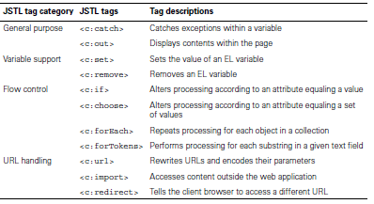
JSTL Tag Functions

Slide 194
General Purpose
Printing Text
Without default value:
<c:out value="${any_val}" />
With default value:
<c:out value="${any_val_init}" default="red" />
Exception Handling
<c:catch var="e">
MUST BE ALL JSTL or EL expressions
</c:catch>
<c:out value="${e}" default=“NO EXCEPTION" />

Slide 195
Variable Support
Assigning values to EL variables:
<c:set var="num" value="${4*4}" />
<c:set var="num“>${8*2}</c:set>
<c:set var="num">
<c:out value="${8+8}" />
</c:set>
NOTE: JSTL cannot communicate with scriptlets variables unless with the use pageScope!

Slide 196
Variable…
Removing variables from container:
<c:remove var=“num”/>
Assigning POJO getter values to variables:
<jsp:useBean id=“ref” class=“org.orion.training.codes.PojoObj” />
<c:set var=“list” value=“${pageScope.ref.list}”/>
<c:remove var=“list” />

Slide 197
Flow Controls
Conditional processing (<c:if>)
No else tag
requires an attribute called test, which you need to set equal to a boolean expression
literal must be enclosed in single quotes
Sample:
<c:if test="${x == ‘9’}">
<c:out value=“${x}” />
</c:if>

Slide 198
Flow Controls…
Compound Selection Statements
The <c:choose> tag doesn’t take any attributes by itself, but contains a number of <c:when> tags that perform separate comparisons with their test attributes.
Sample:
<c:choose>
<c:when test="${color == 'white'}">
Light!
</c:when>
<c:when test="${color == 'black'}">
Dark!
</c:when>
<c:otherwise>
Colors!
</c:otherwise>
</c:choose>

Slide 199
Flow Controls…
Iterations or Loops
The core library’s <forEach> and <forTokens> tags allow you to repeat processing of the tag’s body content. Using these tags, you can control the number of iterations in three ways:
with a range of numbers: using <forEach> and its begin, end, and step attributes
with the elements in a Java collection: using <forEach> and its items attribute
with the tokens in a String: using <forEach> and its items attribute

Slide 200
Scenario1: Ranges
What covers this area are loops concerning:
Bounded iterations
Array Traversal and Indexing

Slide 201
Scenario 2: Collections
This area concerns more on Collections but unfortunately we do not have Collections in EL.
Solutions:
We use Java beans and stored them in src
Then, using <jsp:useBean/> we instantiate the Java bean in the JSP content
We use <c:set/> to assign the getters to EL variables with the help of pageScope
Then we use <c:forEach/>

Slide 202
Scenario 2: Collections
The following are possible collections:
List
Simple Objects
POJOs
Map within the List
Set
Map

Slide 203
Scenario 3: Tokenizers
<%@ taglib uri="http://java.sun.com/jstl/core_rt" prefix="c" %>
<html><body>
<c:set var="numList" value="one,two,three,four,five,six" />
Output of the forTokens tag:<p>
<table border="1">
<c:forTokens var="num" items="${numList}" delims=",">
<tr><td>${num}</td></tr>
</c:forTokens>
</table>
</body></html>

Slide 204
Accessing URL Information
The last category of tags in the core library deals with URL accessing. The three main tags are
<c:url>, which rewrites URLs and encodes their parameters
<c:import>, which accesses content outside the web application,
<c:redirect>, which tells the client browser to access a different URL

Slide 205
URL Rewriting
This will replace our scriptlet equivalent
How to:
<c:url var=“pName“ value="/page.html" />
<form action=“<c:out value=“${pname}”/>”>…</form>
will give the following variable pagename:
/contextname/page.html
/contextname/page.html;jsessionid=jsessionid (URL rewrite)
How to with hidden parameters:
<c:url value="/page.html" var="pagename">
<c:param name="param1" value="${2*2}"/>
<c:param name="param2" value="${3*3}"/>
</c:url>
will give url asking with request parameters:
/contextname/page.html?param1=4&param2=9

Slide 206
Content Augmentation
You can save the imported content within a variable specified by the var attribute
You can also set the variable’s scope with the scope attribute, or control its encoding with charEncoding
You can add parameters to the URL with <c:param> tags in the <c:import> body
<c:import url="/content.html" var="newstuff" scope="session">
<c:param name="par1" value="val1"/>
<c:param name="par2" value="val2"/>
</c:import>

Slide 207
Send Redirection
This tag functions identically to the HttpServletResponse’s sendRedirect() method
<c:redirect url="/content.html">
<c:param name="par1" value="val1"/>
<c:param name="par2" value="val2"/>
</c:redirect>
To have a rewriting, you can use this together with <c:url/>

Slide 208
Custom Tag Library
The tag library descriptor (TLD) file contains the information that the JSP engine needs to know about the tag library in order to interpret the custom tags on a JSP page
It is an XML document that follows the DTD designated by the JSP specification so that it can be created, read, and understood by all kinds of users, including human users and the JSP engine, as well as other development tools
In essence, it informs the user of a tag library about the usage and behavior of the tags that the library provides

Slide 209
Types of Custom Tag Library
Using the Common Static Methods (Type A)
Using Tag Lib Support APIs (Type B)

Slide 210
Type A: Static Methods
Create a class with all methods to be public and static. All types must Objects; NO primitive types are allowed.
Create a TLD file for each methods
Declare TLD file in web.xml
Use taglib directive to use the methods. Choose your own prefix

Slide 211
Static Methods
package org.itm.training.codes;
public class StrMethods {
public static String upper( String x )
{
return x.toUpperCase();
}
public static int length( String x )
{
return x.length();
}
}

Slide 212
TagLib Descriptor
The Tag Library Descriptor (TLD) is used by the JSP container to interpret pages that include the taglib directives referring to that tag library. It is an XML document that maps action tags to static functions or tag handler classes. You can locate a TLD in two ways:
web.xml taglib element
taglib-uri
uri identifying a Tag Library
taglib-location
location, as a resource, where the TLD file can be found
default mapping

Slide 213
TLD…
The schema for TLD is:
<taglib xmlns="http://java.sun.com/xml/ns/j2ee"
xmlns:xsi="http://www.w3.org/2001/XMLSchema-instance"
xsi:schemaLocation="http://java.sun.com/xml/ns/j2ee/web- jsptaglibrary_2_0.xsd"
version="2.0">

Slide 214
TLD…
In the TLD file, <taglib> is the root followed by the following subelements:
tlibversion | version of the tag library implementation
jspversion | version of the JSP specification the tag library requires
shortname | name that could be used to reference the tag library from a JSP page
uri | uri uniquely identifying the tag library - info string describing the "use" of the tag library
info | string describing the "use" of the tag library

Slide 215
TLD File
<taglib xmlns="http://java.sun.com/xml/ns/j2ee"
xmlns:xsi="http://www.w3.org/2001/XMLSchema-instance"
xsi:schemaLocation="http://java.sun.com/xml/ns/j2ee
web-jsptaglibrary_2_0.xsd"
version="2.0">
<tlib-version>1.0</tlib-version>
<function>
<name>upper</name>
<function-class>org.itm.training.codes.StrMethods</function-class>
<function-signature>
java.lang.String upper(java.lang.String)
</function-signature>
</function>

Slide 216
TLD…
<function>
<name>length</name>
<function-class>org.itm.training.codes.StrMethods</function-class>
<function-signature>
java.lang.int length(java.lang.String)
</function-signature>
</function>
</taglib>

Slide 217
Registerin web.xml
<web-app>
...
<servlet>
…
</servlet>
…
<taglib>
<taglib-uri>
http://www.myfunc/functions
</taglib-uri>
<taglib-location>
/WEB-INF/myFunc/MyFunc.tld
</taglib-location>
</taglib>
…
</web-app>

Slide 218
Type B: Creating Tag Handlers
Interfaces involved in tag handler:
Tag
Used for simple tag handlers not interested in manipulating their body content
BodyTag
An extension of Tag and gives the handler access to its body

Slide 219
Main methods of Tag handlers
doStartTag()
process the start tag of this action
doEndTag()
process the end tag of this action. Called after returning from doStartTag

Slide 220
The doStartTag() method
EVAL_BODY_INCLUDE
process the body of the action but do not create a new BodyContent. Pass the body through without manipulating it. Only valid if you DON'T implement the BodyTag interface.
EVAL_BODY_TAG
process the body of the action and create a new BodyContent. Only valid if you DO implement the BodyTag interface.
SKIP_BODY
do not evaluate the body of the tag

Slide 221
The doEndTag() method
EVAL_PAGE
the rest of the JSP page will be evaluated
SKIP_PAGE
the rest of the JSP page will not be evaluated

Slide 222
Implementations
TagSupport
The TagSupport class is a utility class that implements the Tag interface and adds additional convenience methods including:
getter method for Tag properties
BodyTagSupport
The BodyTagSupport class implements the BodyTag interface and adds additional convenience methods

Slide 223
Implementations…
Methods that interact with the body content include:
doInitBody()
invoked before the body of the tag is evaluated but after body content is set
doAfterBody()
invoked after body content is evaluated
Some of these methods include:
getter for the bodyContent property
getter for the previous out JSPWriter

Slide 224
The PageContext
A tag handler has access to some properties that are set by the JSP container using the methods of the PageContext

Slide 225
TLD Declaration
name | unique action name
tagclass | tag handler class implementing javax.servlet.jsp.tagext.Tag
teiclass | optional subclass of javax.servlet.jsp.tagext.TagExtraInfo
bodycontent | one of three body content types
info | optional tag-specific information
attribute | all attributes of the action

Slide 226
Attributes
Can have the following fields:
name (required)
attribute name
required
if attribute is required or optional
rtexprvalue
if attribute value may be dynamically calculated at runtime by a scriptlet. NOTE: default value is "false", meaning that the attribute has a static value. Make sure you set it to "true" if the attribute value is determined at request time.
elexprvalue
means it can support EL (expression language) values

